Slide 1
The Bible
and
Human Sexuality
Dr. Sylvia Keesmaat
Bible Remixed

Slide 2
Why is this such a difficult conversation?

Slide 3
1. It is a flashpoint for other issues:
-authority of scripture
-what faithfulness looks like
-societal forces in relation to the
church
-fears about a slippery slope
-questions about how we define sin

Slide 4
2. It is a rupture with how we have traditionally viewed the world:
-some have grown up in a binary world
-we are “supposed” to have children
-some have always been told it is wrong
-we make the conversation about sex
and associate the LGBTQ+ community
with promiscuity

Slide 5
3. This conversation or situation triggers uncomfortable feelings
-uncovering of past trauma
-the “yuck” factor of talking about sex
-grief
-shame
-fear

Slide 7
Reformed Hermeneutical Principles
1. Discern the context within the
biblical narrative.

Slide 8
Reformed Hermeneutical Principles
1. Discern the context in the
biblical narrative.
2. Discern the historical context.

Slide 9
Reformed Hermeneutical Principles
1. Discern the context in the biblical
narrative.
2. Discern the historical context.
3. Pay close attention to the meaning of the
text (ie. individual words and textual
context).

Slide 10
Reformed Hermeneutical Principles
1. Discern the context in the biblical
narrative.
2. Discern the historical context.
3. Pay close attention to the meaning of the
text (ie. individual words and textual
context).
4. Discern the analogous context today
(dynamic analogy).

Slide 11
Sexuality as a tool to dominate and humiliate:
Genesis 19: the story of Sodom
Judges 19-21: the Levite’s concubine

Slide 12
Ezekiel 16.49:
“This was the guilt of your sister Sodom: she and her daughters had pride, excess of food, and prosperous ease, but did not aid the poor and needy.”

Slide 13
Jude 7
7 Likewise, Sodom and Gomorrah and the surrounding cities, which, in the same manner as they, indulged in sexual immorality (ekporneusasai) and pursued unnatural lust* (apelthousai sarx heteras), serve as an example by undergoing a punishment of eternal fire.

Slide 14
pursued unnatural lust (NRSV)*
*literally = going after other flesh (not same flesh)
apelthousai sarx heteras
“other flesh”= strangers? angels?

Slide 15
Leviticus 18.22:
“You shall not lie with a man as with a woman; it is an abomination.”

Slide 16
Leviticus 20:13:
“If a man (ish) lies with a male (zachar), as with a woman, both of them have committed an abomination; they shall be put to death; their blood is upon them.”

Slide 17
Leviticus 20:25
25 You shall therefore make a distinction between the clean animal and the unclean and between the unclean bird and the clean; you shall not bring abomination on yourselves by animal or by bird or by anything with which the ground teems, which I have set apart for you to hold unclean.

Slide 18
1 Cor 6.9-10 & 1 Timothy 1.9-10:
malakoi (in 1 Cor 6.9-10)
arsenokoitai (in 1 Timothy 1.9-10)

Slide 19
1 Cor 6.9-10 (NRSV):
“Do not be deceived! Fornicators (pornoi), idolaters, adulterers, male prostitutes (malakoi), sodomites (arsenokoitai), thieves, the greedy, drunkards, revilers, swindlers none of these will inherit the kingdom of God.”

Slide 20
1 Cor 6.9-10 (NIV):
“Do not be deceived! Neither the sexually immoral (pornoi), nor idolaters, nor adulterers, nor men who have sex with men (malakoi, arsenokoitai), nor thieves, nor the greedy, nor drunkards, slanderers, nor swindlers will inherit the kingdom of God.”

Slide 21
1 Cor 6.9-10 & 1 Timothy 1.9-10:
malakoi
literally: soft, lazy, self-indulgent, given to decadent living
arsenokoitai
literally: a word Paul made up by putting together the words arsen (male) + koitē (bed), both found in Lev 18 and 20.

Slide 22
malakoi -used for male prostitutes, who were usually slaves or young boys and often not paid
-not associated with homo-sexuality until 1913
-could have been the ones used for sexual pleasure by the arsenokoitai

Slide 23
arsenokoitai -those who prey on young boys

Slide 24
1 Cor 6.9-10 better:
“Do not be deceived! Sexually immoral (pornoi), idolaters, adulterers, male prostitutes (malakoi), men who prey on young boys (arsenokoitai), thieves, the greedy, drunkards, revilers, swindlers none of these will inherit the kingdom of God.”

Slide 25
1 Timothy 1:9-10:
This means understanding that the law is laid down not for the righteous but for the lawless and disobedient, for the godless and sinful, for the unholy and profane, for those who kill their father or mother, for murderers,

Slide 26
10 the sexually immoral (pornois), men who engage in illicit sex (arsenokoitais), slave traders (andrpodistais), liars, perjurers, and whatever else is contrary to the sound teaching 11 that conforms to the glorious gospel of the blessed God, with which I was entrusted.

Slide 27
Romans 1.18-26
-the wrath of God is revealed against the unjust and
ungodly
-those who didn’t see how God was revealed in
creation
-those who worshipped idols
-those are the ones God has given over to degrading
passions leading to sexual violence (vv.26-27)
-and to a debased mind leading to economic
violence (vv.28-32)

Slide 28
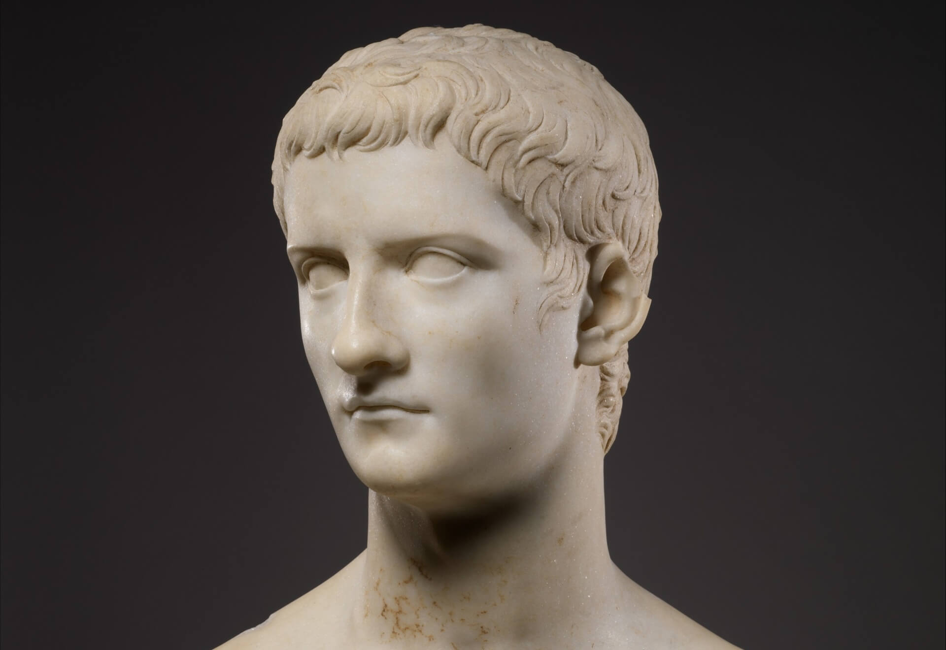
Caligula
(37-41 CE)

Slide 29
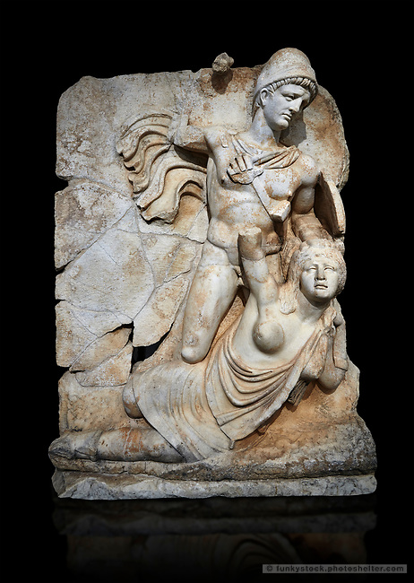
Claudius
(41-54 CE)
and Brittiania

Slide 30
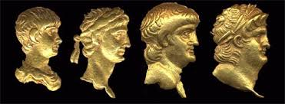
Nero
(54-69 CE)

Slide 31
Romans 1.26-27
26 For this reason God gave them over to dishon-ourable passions. Their females exchanged nat-ural intercourse for unnatural, 27 and in the same way also the males, giving up natural inter-course with females, were consumed with their passionate desires for one another. Males com-mitted shameless acts with males and received in their own persons the due penalty for their error.

Slide 32
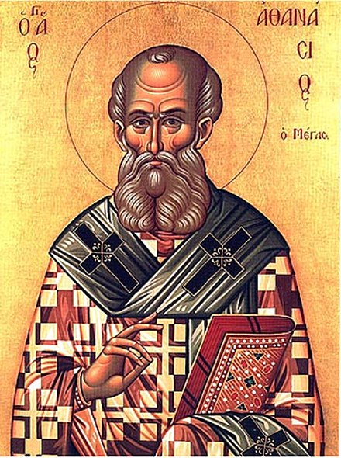
Athaniasius (296-373 CE)
in Contra Gentes
Romans 1.26 referred to cultic prostitution and the sexual rites between men and women in festivals to pagan gods.

Slide 33
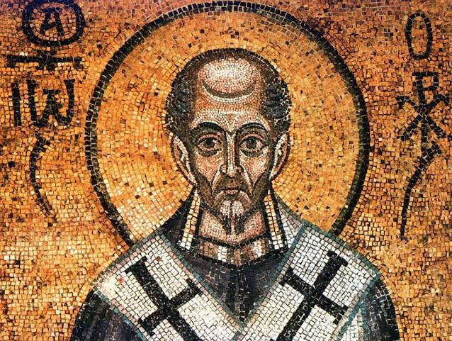
Chrysostom (347-407 CE) in his Homily on Romans
Romans 1.26 referred to cultic
prostitution and
the sexual rites
between men and
women in festivals
to pagan gods.

Slide 34
Ambrosiaster, Commentary on the Thirteen Pauline Letters (366-384 CE).
Ambrosiaster was the first to interpret this verse as referring to same-sex relations between women, and when that interpretation was introduced, it had to be argued for.

Slide 35
Romans 1.18-20
¹⁸ The wrath of God is being revealed from heaven against all the godlessness and injustice of people who suppress the truth by their injustice, ¹⁹ since what may be known about God is plain to them, because God has made it plain to them. ²⁰ For since the creation of the world God’s invisible qualities—God’s eternal power and divine nature—have been clearly seen, being understood from what has been made, so that people are without excuse.

Slide 36
Day | What the Text tells us Was Created
Day 1 | Light and Darkness

Slide 37
Day | What the Text tells us Was Created
Day 1 | Light and Darkness
Day 2 | Waters Below and Sky above

Slide 38
Day | What the Text tells us Was Created
Day 1 | Light and Darkness
Day 2 | Waters Below and Sky above
Day 3 | Dry land and Seas

Slide 39
Day | What the Text tells us Was Created
Day 1 | Light and Darkness
Day 2 | Waters Below and Sky above
Day 3 | Dry land and Seas
Day 4 | Sun to rule the day; moon to rule the night

Slide 40
Day | What the Text tells us Was Created
Day 5 | Creatures that swim in the waters, birds that fly in the sky

Slide 41
Day | What the Text tells us Was Created
Day 5 | Creatures that swim in the waters, birds that fly in the sky
Day 6 | Animals on the earth; Humanity: Male and Female

Slide 42
Day | What the Text tells us Was Created
Day 1 | Light and Darkness
Day 2 | Waters Below and Sky above
Day 3 | Dry land and Seas
Day 4 | Sun to rule the day; moon to rule the night
Day 5 | Creatures that swim in the waters, birds that fly in the sky
Day 6 | Animals on the earth; Humanity: Male and Female

Slide 43
Day | What the Text Tells Us Was Created | How the World Actually Works
Day 1 | Light and Darkness | Twilight, Dusk, Dawn

Slide 44
Day | What the Text Tells Us Was Created | How the World Actually Works
Day 1 | Light and Darkness | Twilight, Dusk, Dawn
Day 2 | Waters Below and Sky above | Rain, the Hydro-logical Cycle

Slide 45
Day | What the Text Tells Us Was Created | How the World Actually Works
Day 1 | Light and Darkness | Twilight, Dusk, Dawn
Day 2 | Waters Below and Sky above | Rain, the Hydro-logical Cycle
Day 3 | Dry land and Seas | Marsh, wetlands, swamps

Slide 46
Day | What the Text Tells Us Was Created | How the World Actually Works
Day 4 | Sun to rule day; moon to rule night | Moon in the daytime

Slide 47
Day | What the Text Tells Us Was Created | How the World Actually Works
Day 4 | Sun to rule day; moon to rule night | Moon in the daytime
Day 5 | Creatures that swim in the waters, birds that fly in the sky | Amphibians, gannets, puffins, ducks etc.

Slide 48
Day | What the Text Tells Us Was Created | How the World Actually Works
Day 6 | Animals that move on the earth; Humanity: male and female | Amphibians. Humanity: 1-2% of people are intersex (1.7% of people are redheads)

Slide 49
Day | What the Text tells us Was Created | How the World Actually Works
Day 1 | Light and Darkness | Twilight, Dusk, Dawn
Day 2 | Waters Below and Sky above | Rain, the Hydrological Cycle
Day 3 | Dry land and Seas | Marsh, wetlands, swamps
Day 4 | Sun to rule the day; moon to rule the night | Moon in the daytime
Day 5 | Creatures that swim in the waters, birds that fly in the sky | Amphibians, gannets, puffins, ducks etc.
Day 6 | Animals that move on the earth; Humanity: male and female | Amphibians, Humanity: 1-2% of people are intersex (1.7% of people are redheads)

Slide 50
Genesis 2.7:
'adam
from
'adamah

Slide 51
'adam = earth creature, earthling
from
'adamah = the earth
no sexual differentiation (not “male”)

Slide 52
Genesis 2.23:
ish = man / male
ishah = woman / female

Slide 53
Genesis 2:24:
Therefore a man leaves his father and mother and clings to his wife, and they become one flesh.
-this was not actually how it worked in the ancient world

Slide 54
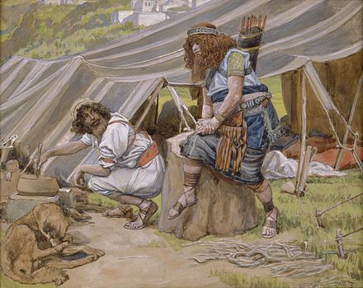
Genesis 25.37
²⁷ When the boys grew up, Esau was a skillful hunter, a man of the field, while Jacob was a quiet man, living in tents.

Slide 55
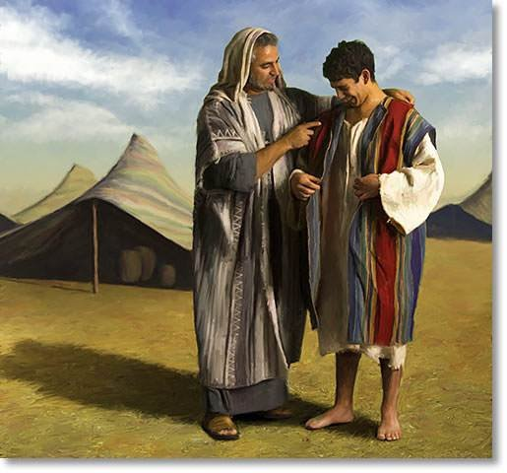
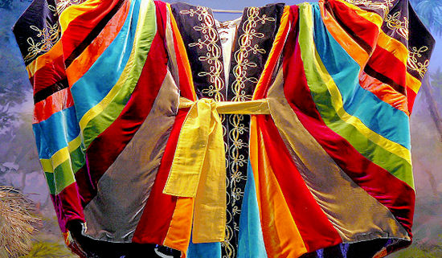
Genesis 37.2-4

Slide 56
ketonet passim
-a coat of many colours
(=expensive)
-a robe with long sleeves
(=like a princess might wear)
-an ornamented robe
(=like a princess might wear)

Slide 57
2 Sam 13.18,19 - Tamar
18 (Now she was wearing an ketonet passim, for this is how the virgin daughters of the king were clothed in robes in earlier times.) So his servant put her out and bolted the door after her. 19 But Tamar put ashes on her head and tore the ketonet passim that she was wearing; she put her hand on her head and went away, crying aloud as she went.

Slide 58
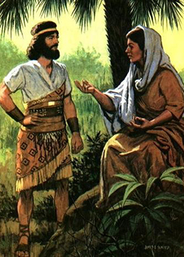
Judges 4-5
Deborah, the prophet who was judging Israel, counsels Barak on how to defeat Sisera’s army.

Slide 59
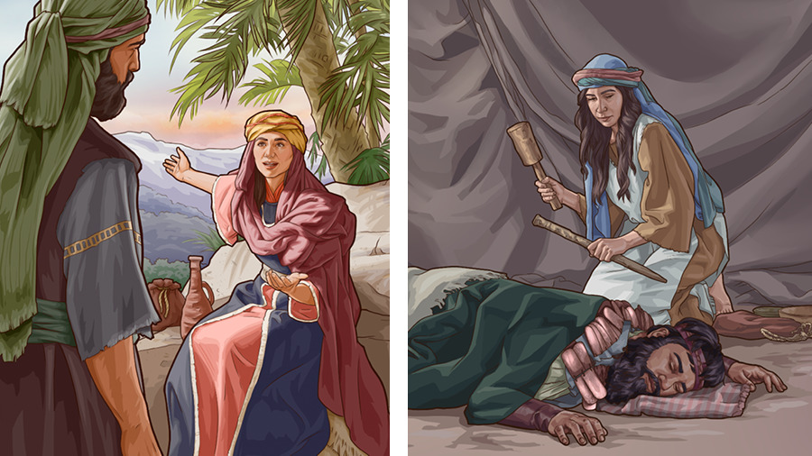
Jael, the wife of Heber, the Kenite invites Sisera into her tent.

Slide 60
Jael puts a tent peg through Sisera’s temple.

Slide 61
Claudius and Brittiania

Slide 62
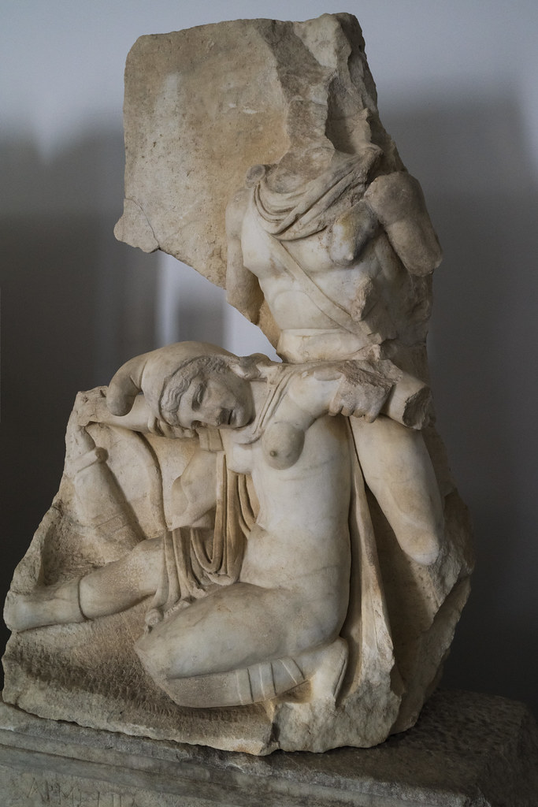
Nero
and a
Phrygian
Woman

Slide 63
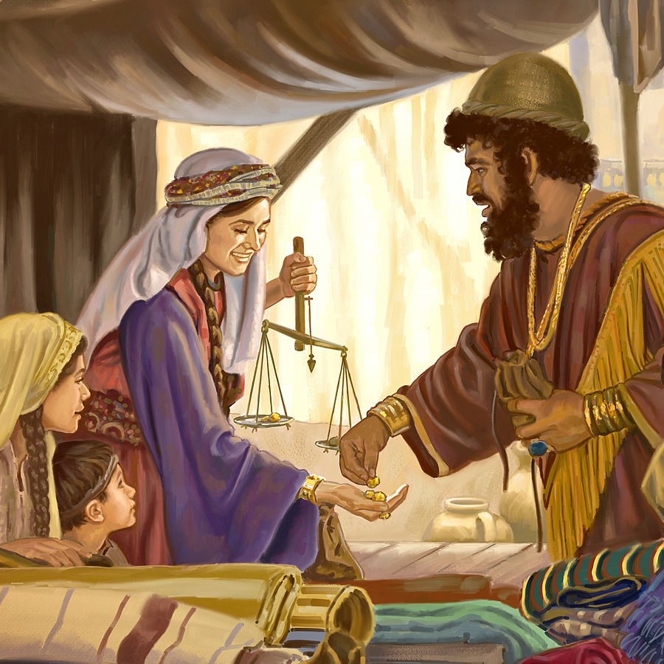
Proverbs 31.10-31
10 A valiant woman who can find?
-“valiant” a word used for warriors

Slide 64
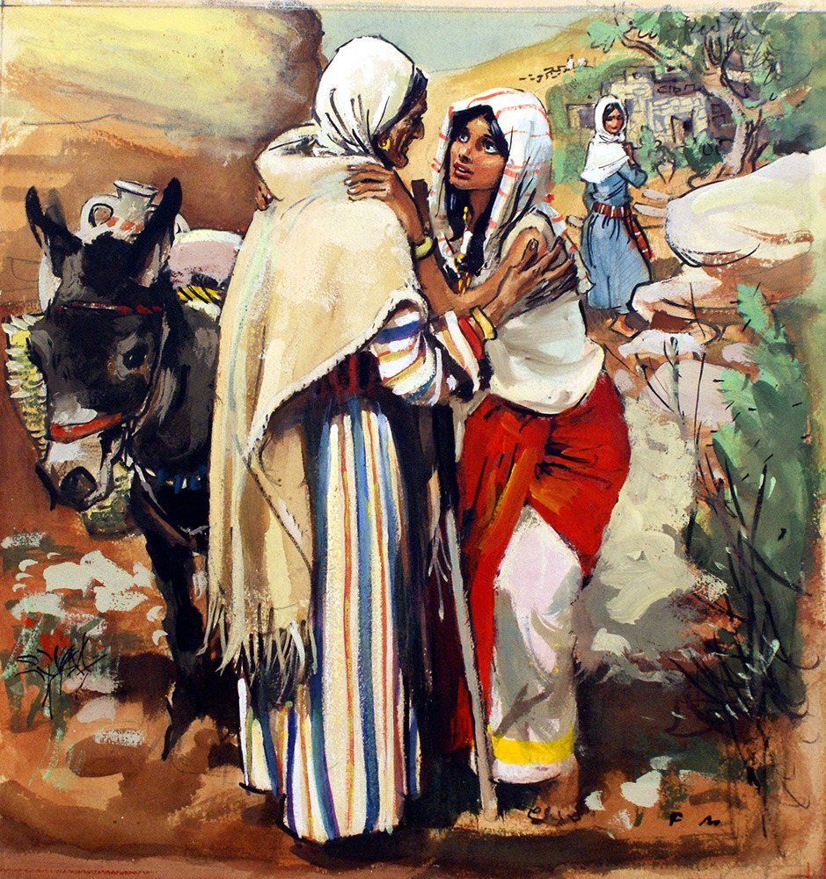
Ruth (the Moabite)
and Naomi
Ruth is also called valiant by Boaz

Slide 66
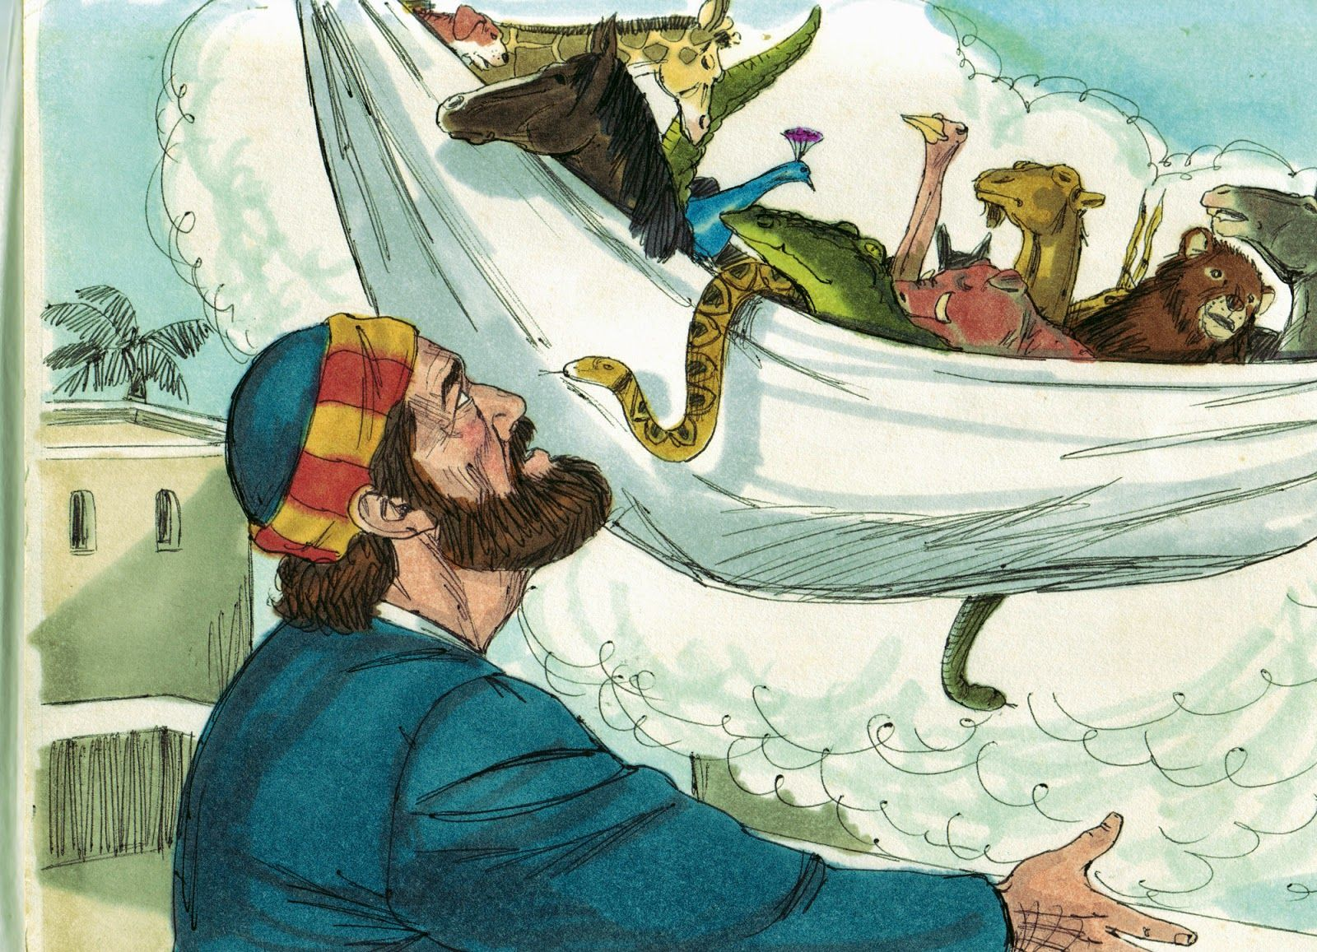
Acts 10:9-16
“Then he heard a voice saying , “Get up, Peter; kill and eat.” But Peter said, “By no means, Lord: for I have never eaten anything that is profane or unclean.” The voice said to him again, a second time, “What God has made clean, you must not call profane.” This happened three times.

Slide 67
Men arrive from Cornelius: a centurion of the Italian Cohort, as it was called. He was a devout man who feared God with all his household; he gave alms generously to the people and prayed constantly to God. The Spirit tells Peter to go with them. (Acts 10)

Slide 68
Acts 10:45-48
⁴⁵ The circumcised believers who had come with Peter were astonished that the gift of the Holy Spirit had been poured out even on Gentiles. ⁴⁶ For they heard them speaking in tongues and praising God.
Then Peter said, ⁴⁷ “Surely no one can stand in the way of their being baptized with water. They have received the Holy Spirit just as we have.” ⁴⁸ So he ordered that they be baptized in the name of Jesus Christ. Then they asked Peter to stay with them for a few days.

Slide 69
Gentiles were considered by Jews to be:
-idolatrous
-impure
-ruled by degrading passions
-sexually immoral and violent
-filled with injustice
-greedy and envious
-haughty and boastful
-crafty and full of deceit
-faithless and ruthless

Slide 70
Acts 15
A council in Jerusalem to determine:
-Should immoral Gentiles be allowed into the community without being circumcised?
(circumcision was a sign they had given up their idolatrous and immoral lifestyle)

Slide 71
The Pharisees: according to the law of Moses they have to be baptized (this is what the scriptures say).
Peter, Barnabas, Paul: the Holy Spirit is working through these Gentiles and they should be welcomed in without imposing circumcision (this is what the Spirit is telling us).

Slide 72
If Acts is our model, then any decisions we struggle through as a community need to include:
1. The sharing of stories.

Slide 73
If Acts is our model, then any decisions we struggle through as a community need to include:
1. The sharing of stories.
2. The sharing of food and the creation of community.

Slide 74
If Acts is our model, then any decisions we struggle through as a community need to include:
1. The sharing of stories.
2. The sharing of food and the creation of community.
3. The discernment of where the Spirit is working: where generosity, faithfulness and the fruit of the Spirit are evident in the lives of all believers.
4. Discernment about how we interpret Scripture in light of these experiences.

Slide 75
Torn: Rescuing the Gospel from the Gays-vs-Christians Debate
by Justin Lee

Slide 76
Changing Our Mind
by David P. Gushee

Slide 77
The Hesed Project
resources and stories about faith, sexuality and gender identity
https://www.hesedprojectcrc.org/

Slide 78
All One Body
-videos by pastors and scholars responding to the Human Sexuality Report
https://www.allonebody.org/

Slide 79
www.bibleremixed.ca
https://www.bibleremixed.ca/links-to-online-articles-and-sermons
Romans Disarmed: Resisting Empire, Demanding Justice
by Sylvia Keesmaat and Brian Walsh. Chapter 9 is on sexuality

